Slide 1
PROGRESS EVALUATION
GNN-Based Dynamic User Pairing and Slot Assignment for Hybrid NOMA Networks
Bagili Akshaya (2520040084)
Monica Raghini Chelle (2520040093)
Swarna Asritha(2520040114)
Guide: Mr. N Lava Prasad, Assistant Professor

Slide 2

Problem Statement
NOMA lets users share a slot
The choice of pair matters
Trying every pairing is slow
Serves more users than there are orthogonal slots
Poor pairs cause interference and user outage
945 possible pairings for just 10 users
Our Goal
  Learn user pairing and slot preference with a GNN
  Match the search-based reference
  Run much faster than exhaustive search
  Keep sum rate high, outage low
2 / 10

Slide 3
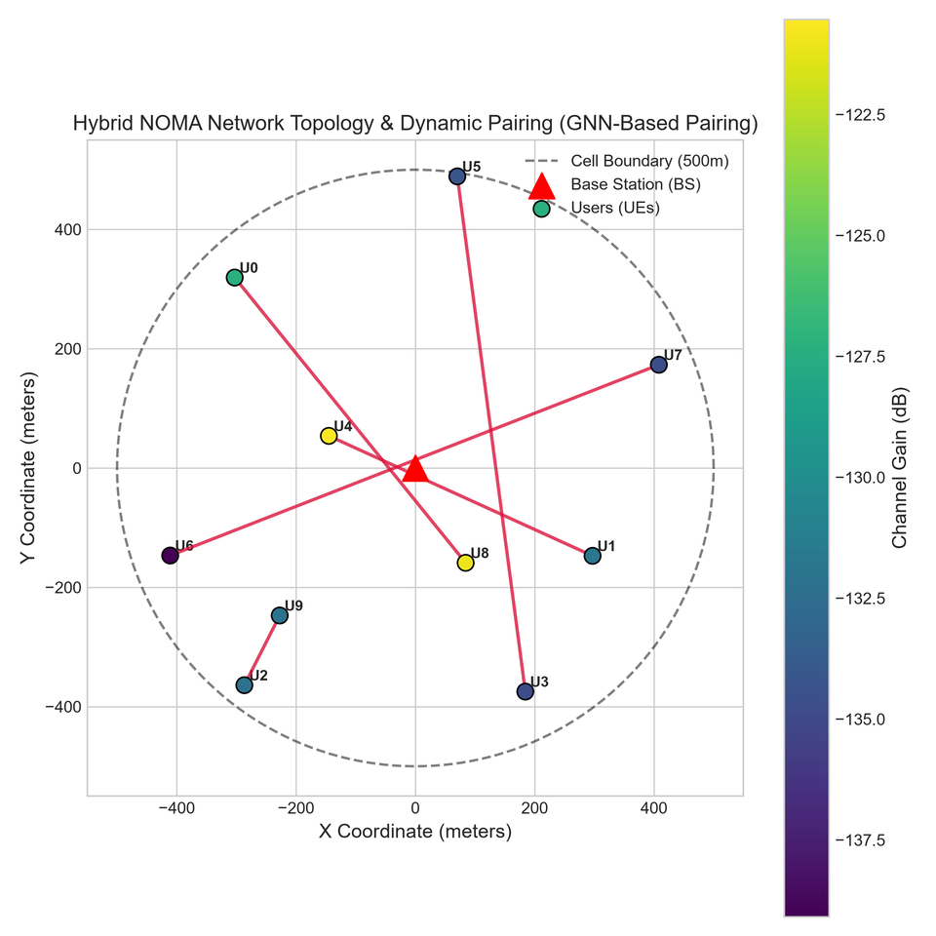
System Setup & Dataset
Network
  Single cell, 1 base station
  10 users, 20–500 m from the BS
  5 slots, 10 MHz band, 1 W total power
  Path loss + Rayleigh fading
Data (synthetic)
  Generated by the program; no external dataset
  200 train / 40 validation / 50 test networks
  Node: position, distance, gain, rate need
  Edge: distance, gain ratio, correlation, interference
Example network: 10 users, GNN pairs shown as lines
3 / 10

Slide 4
Proposed Methodology
1 Reference labels
2 GNN learns
3 Scheduler
  Exhaustive search over all pairings
  Gives pair and slot labels for training
  Input: graph of users
  Output: pair scores + slot preferences
  Trained by imitating the labels
  Greedy matching gives pairs
  Greedy step gives one pair per slot
  PD-NOMA (SIC) or SCMA-style rate per pair
›
›
Role of the GNN: it outputs pair scores and slot preferences. Final pairs and slots come from the rule-based steps.
4 / 10

Slide 5
Project Workflow / Implementation
1
2
3
4
5
6
Generate channels
Reference labels
Build user graph
Train GNN
Pair users + assign slots
Evaluate + plot
channel_model.py
optimization.py
graph_builder.py
gnn_model.py
training.py
pairing.py
slot_assignment.py
evaluation.py
visualization.py
Outputs
Run and check
  Trained model, metrics CSV / JSON
  Figures and summary report
  python main.py --users 10 --epochs 25
  32 automated tests pass
5 / 10

Slide 6
Compared Methods & Communication Models
Communication models
Pairing methods compared
  PD-NOMA: 2 users per slot, SIC at the strong user
  SCMA: MPA detector tested separately; scheduler uses a rate estimate
  OMA: one user per slot
  Random pairing
  Near-Far (weakest with strongest)
  Greedy sum-rate pairing
  Optimization reference (exhaustive)
  GNN pairing (proposed)
All methods use the same 50 test networks.
6 / 10

Slide 7
Simulation Results
Communication Performance
Key Observations
Method | Sum rate (Mbps) | Jain fairness | Outage
OMA | 19.90 | 0.347 | 50.33 %
Random pairing | 15.64 | 0.594 | 1.67 %
Near-Far pairing | 15.80 | 0.550 | 1.00 %
Greedy pairing | 16.66 | 0.522 | 5.33 %
Optimization reference | 17.00 | 0.547 | 1.33 %
GNN pairing | 16.51 | 0.542 | 4.67 %
GNN close to the reference
16.51 vs 17.00 Mbps; fairness 0.542 vs 0.547
GNN outage: 4.67 %
Reference outage is 1.33 %
OMA: high rate, 50.33 % outage
Only one user can use a slot at a time
No exhaustive search at inference
GNN gives a learned pairing solution
Network Configuration
Users: 6 · Slots: 3 · Train / Val / Test: 200 / 40 / 50 · Data: Synthetic
7 / 10

Slide 8
Current Progress
✓
Synthetic wireless data generation
Channel conditions and user features generated programmatically
✓
Graph construction
User position, distance, channel gain and rate requirement used as features
✓
Exhaustive reference generation
Search-based reference used to provide pairing labels
✓
GNN pairing and slot preference
GNN predicts suitable user pairs and slot preferences
✓
Multiple pairing methods
Random, Near-Far, Greedy, Optimization and GNN
✓
PD-NOMA with SIC
Power-domain NOMA with Successive Interference Cancellation
✓
SCMA detector
SCMA MPA detector evaluated using BER, SER and SNR
✓
Classical ML baselines
Linear Regression and Random Forest evaluated
✓
Automated evaluation and outputs
Graphs, CSV / JSON results and automated tests
Current GNN result: 16.51 Mbps total rate · 2.75 Mbps average user rate
SCMA detector is implemented and evaluated; deeper scheduler integration remains future work.
8 / 10

Slide 9
Remaining Work
1
Complete SCMA–scheduler integration
Connect the actual SCMA detector directly with the hybrid scheduler instead of using only a rate estimate.
2
Train GNN on the final objective
Move beyond imitating reference labels; directly optimize for high sum rate, low outage and good fairness.
3
4
Improve scalability
Support larger numbers of users and more user pairs without dropping extra pairs.
Validate across multiple random seeds
Run multiple independent experiments and report variation / confidence intervals.
Core GNN-based pairing and communication evaluation pipeline is implemented and experimentally validated.
9 / 10

Slide 10
Thank You
GIthub: https://github.com/monicachelle/hybrid-gnn-noma.git
https://github.com/asrithaswarna/Hybrid-NOMA

